Slide 1




Not All Claims are Created Equal: Choosing the Right Statistical Approach to Assess Hypotheses
Erfan Sadeqi-Azer Daniel Khashabi Ashish Sabharwal Dan Roth
Indiana University (now at Google) Allen Institute for AI Allen Institute for AI Univ. of Pennsylvania
Notes:
Hi everybody!
I am Daniel Khashabi, from Allen Institute for AI and I am going to give you a short presentation on our ACL work: …

Slide 2
This work
Q: What is this work about?
Q: What do you mean by “hypothesis”?
Q: Why should I care about hypothesis assessment?
Different hypothesis assessment algorithms and their comparison
it’s a prediction, based on certain assumptions & observations e.g., classifier-1 is inherently better than classifier-2
Like any empirical field, in NLP we need to follow scientific principles
for drawing conclusions.
Notes:
Let's start with the highlevels:
First, what is this work about? … In this work we go over several already-known
What do we mean by a hypothesis?
Why should … But, as I'll show shortly, the NLP community is not doing a good job at this.

Slide 3
Statistical tools considered in this work
p-value
Bayes Factor
Confidence Interval
Posterior Interval
Notes:
Here the four assessment tool we review in the paper.
Read them . . .
Later, very briefly I am going to explain these techniques and how they differ.

Slide 4
Contributions
Quantify usage trends in NLP community:
Annotated ACL’18 papers (~440 papers)
Surveyed ~50 random NLP practitioners
Findings:
Lack of awareness about various algorithms.
Poor interpretation of statistical tools – especially the popular ones.
Misleading reporting, resulting in unintended conclusions.
A Python package for Bayesian statistical hypothesis assessment
https://github.com/allenai/HyBayes
Notes:
What are the contributions in this work?
To gain a better understanding of how NLP community is using hypothesis testing, we did a bunch of quantitative analysis:
We annotated ACL 2018 papers with the testing algorithms that they use.
We conducted a survey among a randomly selected pool of researchers, to gain intuition about common misinterpretations and misunderstandings among researchers.
We observed that:
- there is Lack of awareness about various algorithms … resulting in a skewed usage of the tools; some are overused and some are completely absence
- We showed that many of us researchers, have major difficulties in interpreting statistical tools, especially the commonly-use ones.
- we pointed out several common misleading reporting practices, resulting in unintended conclusions.
And finally, we have created a python package for the community, to fascilitate access to several cool testing algorithms that are under-used & but have benefits over the over-used ones.

Slide 5
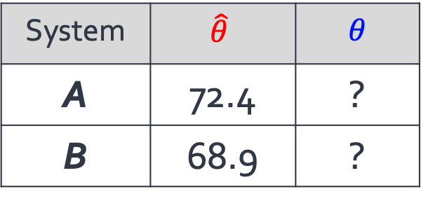
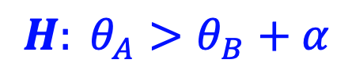
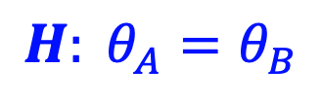
A Typical AI Experiment
The apparent difference in empirical performances be explained simply by random chance.
We have sufficient evidence to conclude that A is in fact inherently stronger than B.
$$H: θ_{A}=θ_{B}$$
Empirical performance
Inherent performance
System | $$\hat{θ}$$ | $θ$
A | 72.4 | ?
B | 68.9 | ?
$$H: θ_{A}>θ_{B}+α$$
(Clark et al., 2018)
|D|= 2376
Notes:
A good portion of NLP research focuses on developing new systems. That's why we often find ourselves comparing the performance of systems.
Here is an example of such comparison, taken from an actual NLP paper. Based on an experiment done on a dataset, we have empirical performance estimates for two system A and B.
It is important to notice that these empirical values are noisy, partly because they’re done on limited samples.
As a result, what we're actually interested in is the inherent measures of accuracy, a notion that is not directly observed.
So based on our observed values, we'd hypothesize about inherent metrics:
A hypothesis could be: - …..
- …. just to emphasize the point, when forming a hypothesis, we’re talking about the inherent, unobserved attributes of the systems. Now the question is: how would you go about assessing any of these hypotheses.

Slide 6
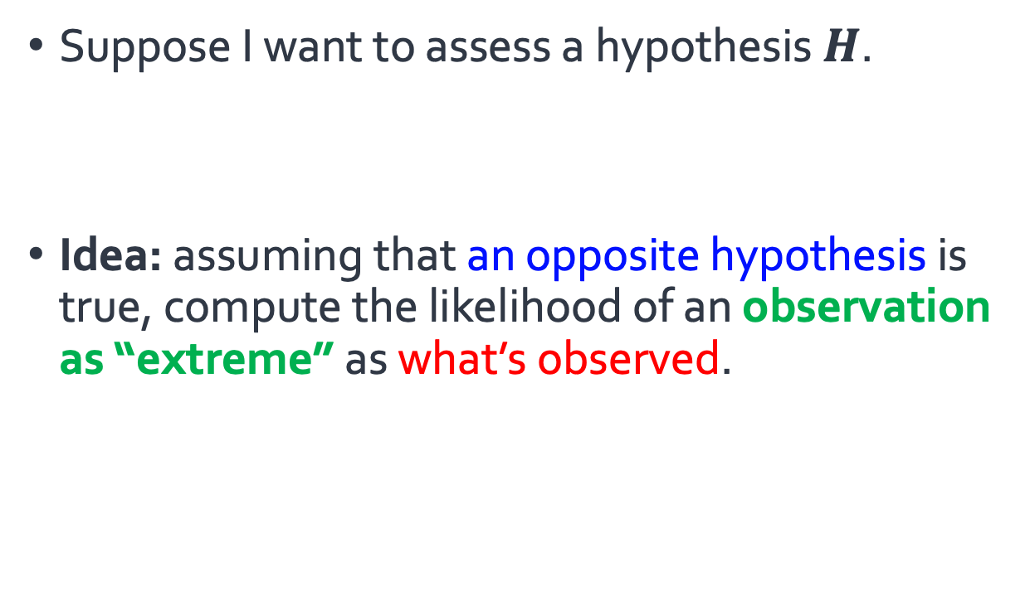
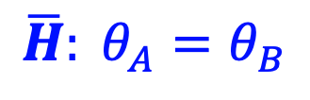
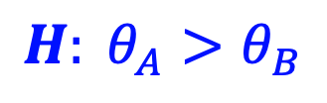
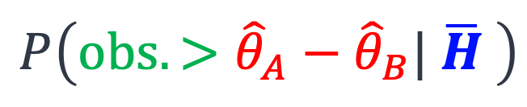
Statistical tools: big picture
Suppose I want to assess a hypothesis $H$.
Idea: assuming that an opposite hypothesis is true, compute the likelihood of an observation as “extreme” as what’s observed.
$$H: θ_{A}>θ_{B}$$
$$\overline{H}: θ_{A}=θ_{B}$$
p-value
Bayes Factor
Confidence Interval
Posterior Intervals
the accuracy gap between the two systems
$$P\left(obs. >{\hat{θ}}_{A}−{\hat{θ}}_{B}| \overline{H} \right)$$
p-value
Notes:
Here I am giving a super high-level description of the algorithms we considered in the work:
Let’s start with the left-most two algorithms.
Suppose I want to assess a hypothesis H. The two algorithms on the left share an underlying inference principle.
Here is the idea: let's assume that the opposite is true; if that's the case, if we were to repeat the experiment, what is the likelihood of making observation that is at least as extreme as our current observations.
In the context of our NLP example, “extremeness” refers to the accuracy gap between the two systems.
To show this in terms of equations, here how it would look like:
This definition is so important that we have a name for it: it's called p-value and it is also used in computation of confidence intervals.

Slide 7
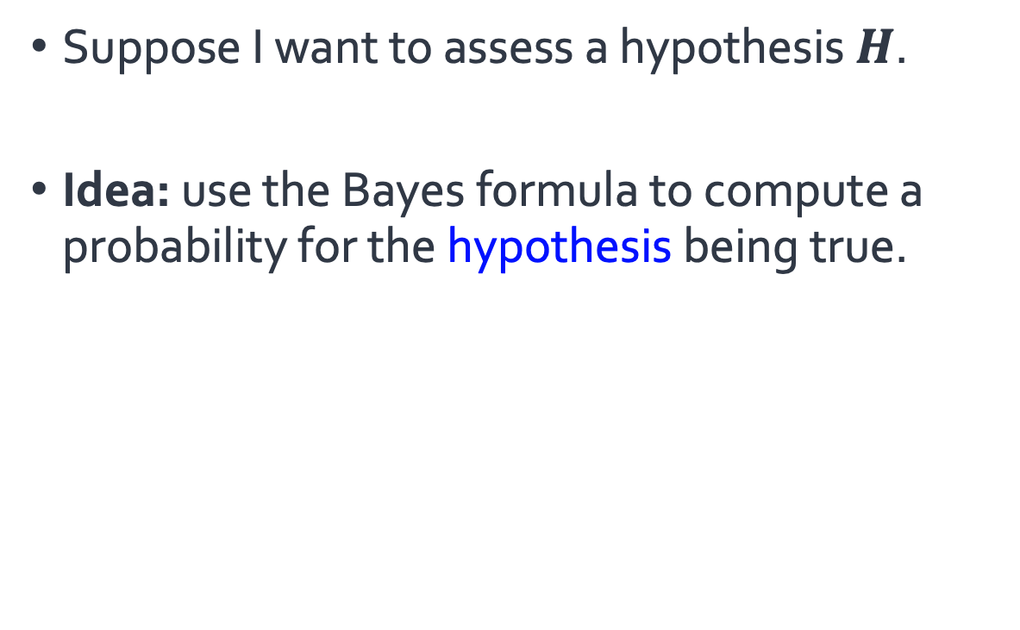
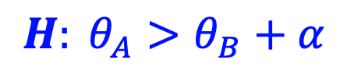
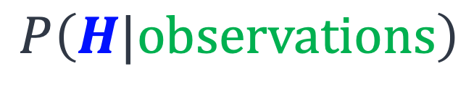
Statistical tools: big picture
Suppose I want to assess a hypothesis $H$.
Idea: use the Bayes formula to compute a probability for the hypothesis being true.
Frequentist
Bayesian
p-value
Bayes Factor
$$H: θ_{A}>θ_{B}+α$$
Confidence Interval
Posterior Intervals
$$P\left(H|observations\right)$$
Notes:
Now let’s look at the other two algorithms:
Not surprisingly, since these algorithms use the Bayesian principle, we call them Bayesian assessment algorithms.
This is in contrast with other group of tests on the left that use Frequentist inference principles.

Slide 8
Ease of Interpretation
Usage Patterns
Notes:
Now that we understand some high-level notions of the algorithms, let's look at two issues related to their usage.
Due to the limited time of this presentation, I am showing only two aspects to these algorithms.
You can find more comparisons in the paper.
Let’s start with the usage patterns:

Slide 9
Trends and Patterns in the field
Study NLP conference papers: ACL’18 papers (439 papers)
How many papers did use significance testing?
73
0
Many papers (~360) did not include any hypothesis assessment.
p-value based tests are the dominant choice among NLP practitioners.
p-value
Bayes Factor
Confidence Interval
Posterior Intervals
6
0
Why?
Notes:
To better understand the common practices in the field, we went through ACL'18 papers and counted how many times each of these statistical assessment tools are used.
this shows ...
Now the question is what is the reason behind this imbalanced usage of the statistical tools;
Is this an informed decision to behave this way?
Or it is sth something else.

Slide 10
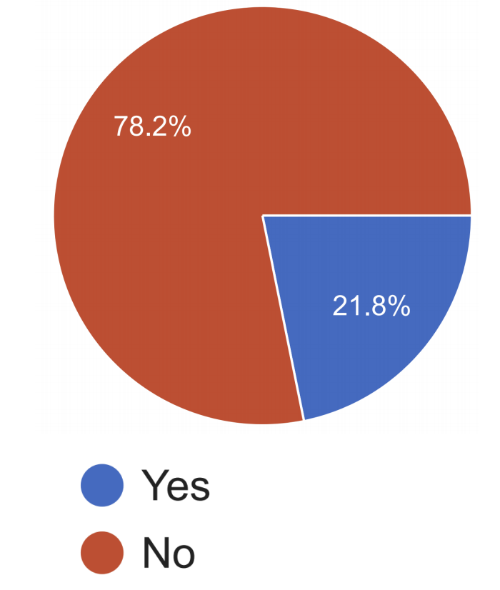
Lack of exposure to alternative algorithms
The imbalance in usage:
Is it intentional?
Many people did not know the definition of “Bayes Factor.” 🤔
Do you know the definition of "Bayes Factor"?
We don’t teach the alternatives in our AI curriculum.
Notes:
To better understand the issue of imbalance, in our survey we include questions about techniques that are under-used. Basically we wanna understand whether people knowingly ignore these algorithms, or they just don't know about them.
For example, we ask:
Turns out that:
The point here is that: maybe we have a lack of exposure problem in the field, possibly because these definitions are not included in their academic curiculum.

Slide 11
NLP community is over-using certain techniques.
One reason could be researchers’ lack of exposure to the alternatives.
Ease of Interpretation
Usage Patterns

Slide 12
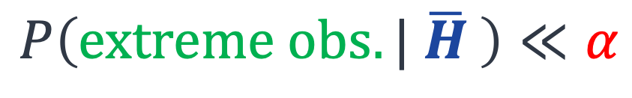
Are we good at interpreting the p-values?
$$P\left(extreme obs.| \overline{H} \right)≪α$$
p-value
“The probability of obtaining test results at least as extreme as the results actually observed during the test, assuming that the null-hypothesis is correct.” --your favorite statistics textbook
Pretty complex notion!
Notes:
Let’s go back to the definition of p-values; and remember that p-values are the most widely used hypothesis testing tool.
If you look at the text-book definition of p-value, you'd typically find a paragraph like this.
Which looks pretty complex.
A natural question is: do people really understand this?

Slide 13
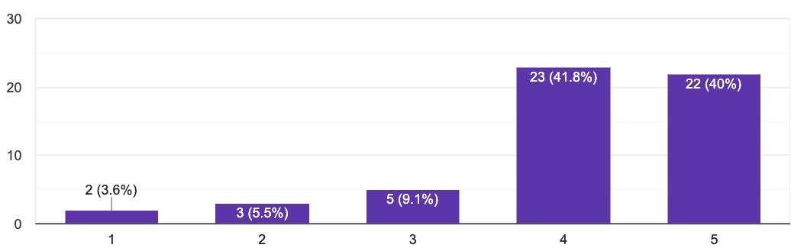
A Survey Question: Interpreting P-value (1)
Question 1: do you know p-values and its interpretation?
86% expressed fair-to-complete confidence in their ability to interpret p-values.
Notes:
Going back to our survey, we include questions to measure this understanding:
First, we ask people whether they think they understand and can interpret p-values?

Slide 14
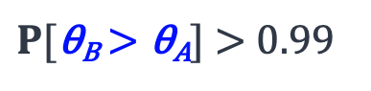
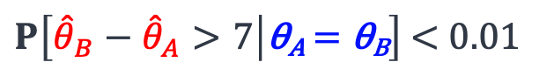
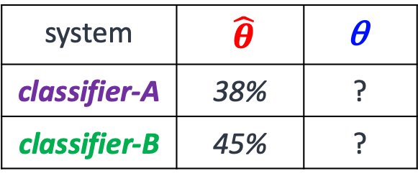
A Survey Question: Interpreting P-value (2)
The authors claim that the improvement of B over A is “statistically significant” with a significance level of 0.01. Which of the followings is correct?
The probability of observing a margin 7% is at most 0.01, assuming that the two classifiers inherently have the same performance.
With a probability 99% classifier-2 will have a higher performance than classifier-1.
…
system | $\hat{θ}$ | $$\text{θ}$$
classifier-A | 38% | ?
classifier-B | 45% | ?
23%
$P\left[{\hat{θ}}_{B}−{\hat{θ}}_{A}>7 | \text{θ}\text{A} \text{=} \text{θ}\text{B}\right]$ < 0.01
30%
$P[\text{θ}\text{B}\text{ > }\text{θ}\text{A}]$ > 0.99
🤦
Only a small percentage correctly answered a basic p-value interpretation question.
Notes:
Then, in the 2nd step, we ask them a question that requires interpreting p-values.
Here I am showing the question,
Based on this (show) table, it says: (read)
Here are two popular candidates among what was provided. Now we don’t have time to go over these candidates; you can check them later on your time.
but here is the correct answer and you
But the key point I want to tell you here is that:
- the popular choice selected by our participants is an incorrect answer.
– and only a small (read)
Eventhough – as we saw in the previous slide --- they were confident about their ability to interpret p-values.

Slide 15
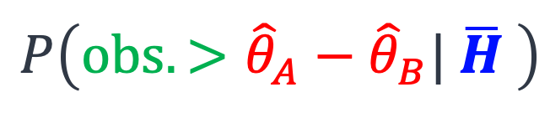

Ease of interpretation: Bayesians vs Freq.
Frequentist
Bayesian
p-value
Bayes Factor
$$P\left(obs. >{\hat{θ}}_{A}−{\hat{θ}}_{B}| \overline{H} \right)$$
$$P\left(H|observations\right)$$
p-value
Confidence Interval
Posterior Intervals
Our participants mistakenly interpret frequentist notions in a Bayesian way.
Notes:
Moreover, there is something interesting about how people misinterpret p-values: most often our participants mistakenly interpret p-values in a Bayesian way.
In other words: we ask them to tell us what this equation here means (show p-value equation), however, they tell us what equation is (show the Bayesian eq.) --- a probably defined over a hypothesis of interest and the definition behind Bayesian hypothesis algorithms.
This may suggest that Bayesian techniques are superior alternatives in terms ease of interpretations.

Slide 16
Ease of Interpretation
Usage Patterns
While p-valued based tests are the most popular choice among NLP practitioners, they’re difficult to understand and highly prone to misunderstanding.
Bayesian Intervals provide results that are more natural to interpret.
Notes:
.. Which is why we wrote this paper to help people understand the alternatives and provided them with a software to make the Bayesian algorithms more accessible.

Slide 17
Summary
The work surveys four different alternatives for hypothesis assessment.
Details in the paper
We provide comparisons among these algorithms:
Whether their easy to interpret / misinterpret
…
We compare usage patterns:
Surveying the field
Manual annotation of papers
HyBayes: https://github.com/allenai/HyBayes
Notes:
…
Last but not least: we have created a Python package for Bayesian statistical hypothesis assessment
Please give it a try and give us feedback.

Slide 19
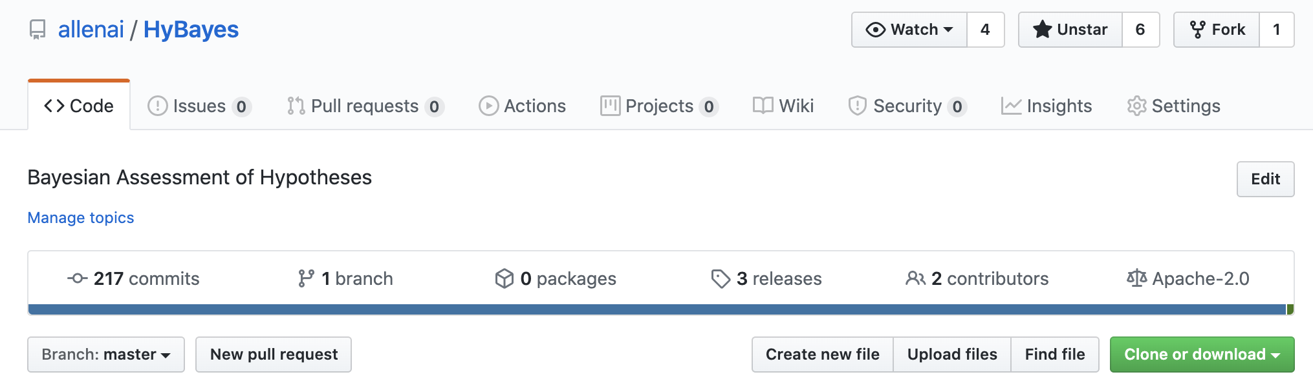
https://github.com/allenai/HyBayes
Notes:
Last but not least: we have created a Python package for Bayesian statistical hypothesis assessment
Please give it a try and give us feedback.

Slide 20
That’s it!

Slide 21
Contributions
Review different hypothesis assessment tools and provide comparisons.
Quantify usage trends in NLP community:
Annotating ACL’18 papers (~440 papers)
Survey among 50 random NLP practitioners
A Python package for Bayesian statistical hypothesis assessment
https://github.com/allenai/HyBayes
Notes:
The contributions of this work are:
- We review different hypothesis assessment tools and proivide comparisons among them.
- To gain a better understanding of how the NLP community is using these algorithms, we quantify the usage trends in two ways:
- We annotated ACL 2018 papers with the testing algorithms that they use.
- We conduct a survey among a randomly selected pool of researchers, to gain intuition about common misinterpretations and misunderstandings among researchers.
And finally, we have created a python package to fascilitate access to several cool testing algorithms that are under-used in our community.

Slide 22
Summary of Findings
Lack of awareness about various algorithms; e.g., Bayesian hypothesis assessment.
Inability to interpret statistical tools – especially the popular ones.
Misleading reporting, resulting in unintended conclusions.
Notes:
Here are the 3 key findings in the analysis of the paper:
- We observe that there is Lack of awareness about various algorithms - … resulting in a skewed usage of algorithms; some are overused and some are completely absence
- We show that many of us researchers, have major difficulties in interpreting statistical tools, especially the commonly-use ones.
- Finally, we point out several common misleading reporting practices that could result in unintended conclusions.

Slide 23
Survey of NLP practitioners
Question 1: do you know p-values and its interpretation?
Question 2: which is a correct interpretation of p-values?
86% expressed fair-to-complete confidence in their ability to interpret p-values.
🤦
Only a small percentage (23%) correctly answered a basic p-value interpretation question.
Notes:
Going back to our survey, we include two questions to measure this understanding:
First question: we ask people whether they think they understand and can interpret p-values?
2nd question: we ask them a question that requires interpreting p-values.

Slide 24
Intermediate Summary
Null-Hypothesis Significance Tests are the most popular choice among NLP practitioners. Meanwhile, they’re difficult to understand and highly prone to misunderstanding.
P-values do not provide probability estimates on two classifiers being different (or equal).
Frequentist
Bayesian
Binary Decision
Null-Hypothesis Significance Test
Bayes Factor
Statistical significance is different than practical significance.
Uncertainty Estimations
Confidence Interval
Posterior Intervals
Notes:
Inherently, NHST is not designed to answer such queries about uncertainty of claims/hypotheses.

Slide 25
2nd Intermediate Summary
Provides probability estimates over hypothesis of interest.
Easier to interpret → less ambiguous.
Provides a flexible framework
E.g., margin of superiority could incorporated in the definition of hypotheses.
This does not encourage binary decision-making.
Frequentist
Bayesian
Binary Decision
Null-Hypothesis Significance Test
Bayes Factor
Uncertainty Estimations
Confidence Interval
Posterior Intervals
Notes:
Let me try to summarize.

Slide 26
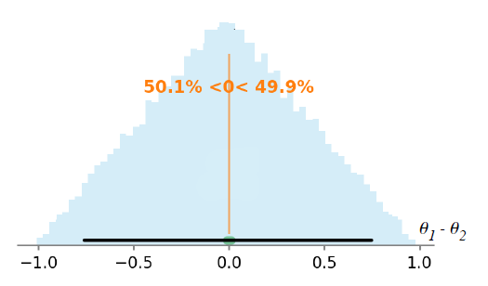
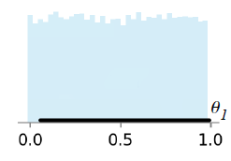
A typical scenario in NLP
Compare two systems A, B.
θ_{A}, θ_{B:} performance measures
Compare θ_{A} vs θ_{B}
Consider a prior Belief on θ_{A} and θ_{B}
For fairness and identical distribution
Notes:
A good portion of NLP research focuses on developing new systems or algorithms to solve certain tasks related to Natural languages. That's why we often find ourselves comparing the performance of multiple systems. Let's consider two systems A and B. And let's assume they have some notion of performance measure theta_a theta_b, respectively. Then our goal is to compare theta_a and theta_b.Before running any experiments on A and B, we might have some prior belief about theta_a and theta_b. [Click], for example, let's say theta is a measure between [0, 1], and we happen to believe any value in this interval is equally likely. If we are unbiased and fair, we go with identical distributions for theta_a and theta_b. [Click]. Since we are more interested in comparison of theta_a and theta_b, [Click], Let's look at the distribution of theta_a - theta_b.

Slide 27
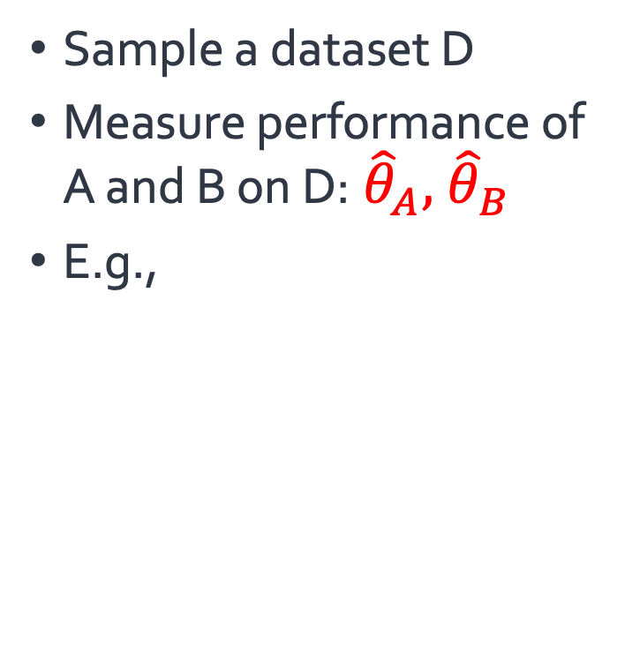
A typical scenario in NLP
Sample a dataset D
Measure performance of A and B on D:${\hat{θ}}_{A},{ \hat{θ}}_{B}$
E.g.,
(Clark et al., 2018)
System | Accuracy
Ⓐ | 72.4
Ⓑ | 68.9
|D|= 2376
Notes:
Since we don't have any direct way of measuring theta_a and theta_b, we go about making a dataset, call it D, and then we record the performance of these two systems on D. Let theta_A_hat and theta_B_hat show the performances of the systems on D [Click]. [Read the table.]

Slide 28
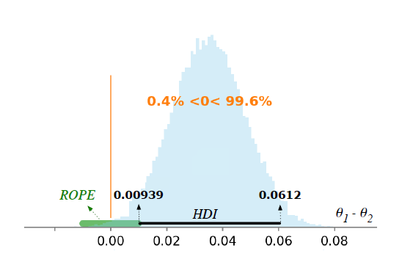
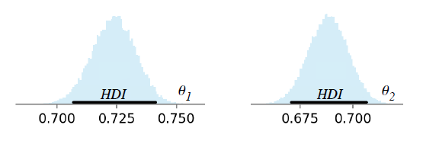
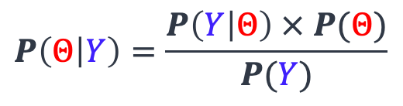
Prior + Observations => Posterior
(Clark et al., 2018)
System | Accuracy
Ⓐ | 72.4
Ⓑ | 68.9
|D|= 2376
$$P\left(Θ | Y\right)=\frac{P\left(Y | Θ\right) × P(Θ)}{P(Y)}$$
Notes:
Now one can use Bayes rule to combine the prior belief with the observations to get a new probability distribution over theta_a and theta_b and [click] more importantly on theta_a – theta_b. These are called posterior distributions.

Slide 29
Prior + Observations => Posterior
(Clark et al., 2018)
System | Accuracy
Ⓐ | 72.4
Ⓑ | 68.9
|D|= 2376
$$P\left(Θ | Y\right)=\frac{P\left(Y | Θ\right) × P(Θ)}{P(Y)}$$
Notes:
One might be interested in a different type of statistics. For example how much the odds of a certain hypothesis changed by observing the observation?

Slide 30
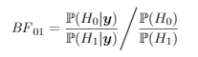
How Observations changed our mind
System | Accuracy
Ⓐ | 72.4
Ⓑ | 68.9
Notes:
This notion is captured on quantity called Bayes factor, and gives another angle to the observations we made.

Slide 31
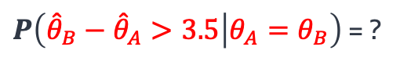
How significant the observations are?
(Clark et al., 2018)
P-value:
System | Accuracy
Ⓐ | 72.4
Ⓑ | 68.9
$P\left({\hat{θ}}_{B}−{\hat{θ}}_{A}>3.5 | θ_{A}=θ_{B}\right)$ = ?
|D|= 2376
Notes:
Another question we can ask about the observations is to choose a point in the theta_a – theta_b axis, and consider a world where that that predicate is true. Then what is probability that my observations would be as extreme as what I observed? A lower value would mean the point I choose likely not correct. This quantity is called p-value and definitely one of the most commonly used statistical tool in NLP research as we will see in a few slides later. This quantity also has the issue that it only talks about validity of one point in the theta_a-theta_b axis and for example if in the real world theta_a was tiny amount higher than theta_b still this quantity can be high

Slide 32
P-value with non-zero Margins
(Clark et al., 2018)
System | Accuracy
Ⓐ | 72.4
Ⓑ | 68.9
$P\left({\hat{θ}}_{B}−{\hat{θ}}_{A}>3.5 | θ_{A}−θ_{B}=a\right)$ = ?
Confidence interval
|D|= 2376
Notes:
To solve that issue, we can slide the point corresponding to the condition of the conditional probability to get validity of different points. The interval in which this probability is higher than some value like 1 or 5 percent is call confidence interval.

Slide 33
Statistical tools in this work . . .
Frequentist
Bayesian
Binary/Categorical Decisions
Null-Hypothesis Significance Test
Bayes Factor
Uncertainty Estimations
Confidence Interval
Posterior Intervals
(Kruschke and Liddell, 2018)
Notes:
The statistical tools considered in the paper are the following four (read them)
The two tools on the left are based on frequentist statistics, while the ones on the right are based on Bayesian inference.
Two distinct interpretation of probabilities which has resulted in two different schools of thought about decision-making problems.
A complementary categorization of these tools is based on the nature of the results that they provide:
the ones on the top encourage binary decision making, while those on the bottom provide uncertainty around estimates.
For the sake of this presentation, to make the talk more focused, we’re going to focus on the red algorithms, but in our paper we cover all 4 of them.
NHST, because it’s the most popular choice
PI, because I believe it’s a useful alternative.

Slide 34
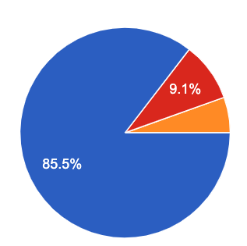
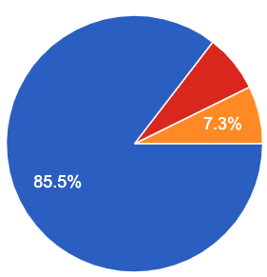
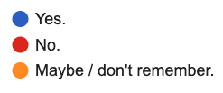
Do the survey participants know hypothesis testing?
“I have learned about statistical hypothesis testing/assessment (via taking classes or reading it from other places).”
“I have used ‘hypothesis testing’ in the past (in a homework, a paper, etc.)”

Slide 35
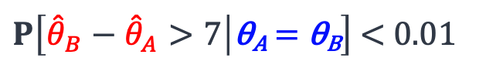
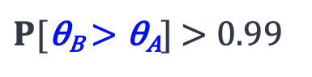
A Survey Question: Interpreting P-value
The authors claim that the improvement of classifier-B over classifier-A is “statistically significant” with a significance level of 0.01. Which of the followings is correct?
The probability of observing a margin 7% is at most 0.01, assuming that the two classifiers inherently have the same performance.
With a probability 99% classifier-2 will have a higher performance than classifier-1.
classifier-A | 38%
classifier-B | 45%
23%
$P\left[{\hat{θ}}_{B}−{\hat{θ}}_{A}>7 | \text{θ}\text{A} \text{=} \text{θ}\text{B}\right]$ < 0.01
30%
$P[\text{θ}\text{B}\text{ > }\text{θ}\text{A}]$ > 0.99
🤦

Slide 36
Ambiguity problem in interpreting “significance”
An NLP paper presents system-A and it compares it with a baseline system-B. In its “abstract” it writes: “... system-A significantly improves over system-B.” What are the right way(s) to interpret this (select all that applies)
It is expected that authors have performed some type of “hypothesis testing.”
It is expected that the authors have reported the performances of two systems on a dataset where system-A has a higher performance than system-B with a notable margin in the dataset.
83%
53%
Notes:
We wanted to verify this; so we included a question in our survey.
We asked out participants ….

Slide 37
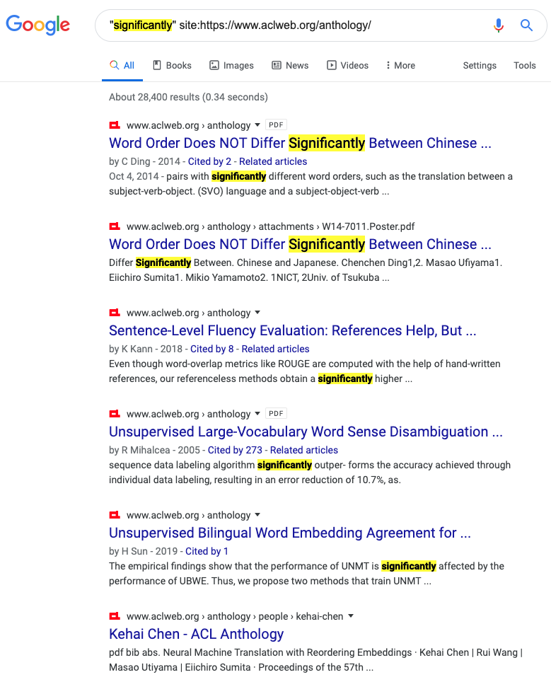
Addition to “significance”
Notes:
There are many issues related to how we report results. But the key point that I wanna highlight here is: how we use the term: "significant" in our papers. Almost any NLP paper contains this term in one form or another. And often such phrasings appear in key parts of papers like their abstracts.

Slide 38
Ambiguity problem in interpreting “significance”
“... system-A significantly improves over system-B.”
Interpretation 1: It is expected that authors have performed some type of “hypothesis testing.”
Interpretation 2: The reported the empirical performance improvement is large.
…
Participants in our survey have different interpretations of “significant.”
Notes:
The problem that we're highlighting is the ambigutiy problem cased by our bad phrasings.
I use "significant"; you use "significant"; our interpretations are not always compatible.
Just to make it more concrete; suppose you red this phrase in an absract:
which confirms that there is an ambiguity proble.

Slide 39
Ambiguity of “significance”: our recommendation
“... system-A significantly improves over system-B.”
When referring to performing some type of “hypothesis testing,” use prefixes like “statistical.”
When referring to big empirical improvements, use alternative terms like “notable” or “remarkable.”
Notes:
To address this ambiguity problem, we have a very simple suggestion for you:

